Slide 1
Sample Images

Slide 2
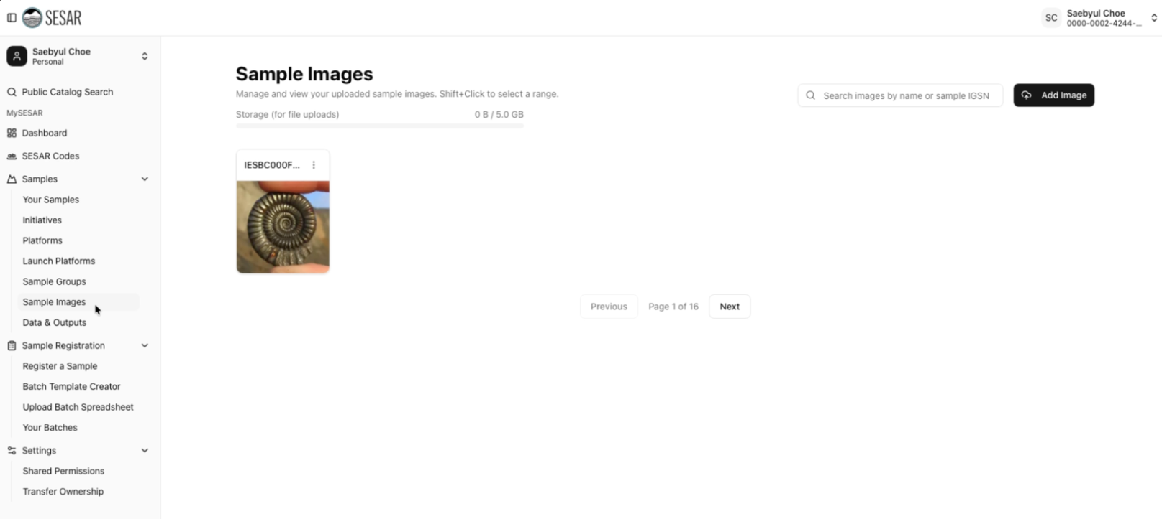
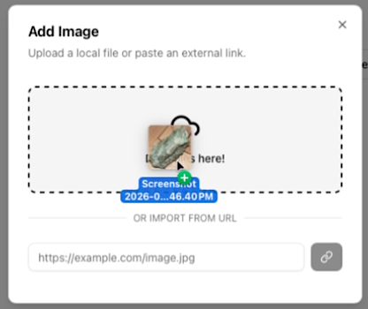
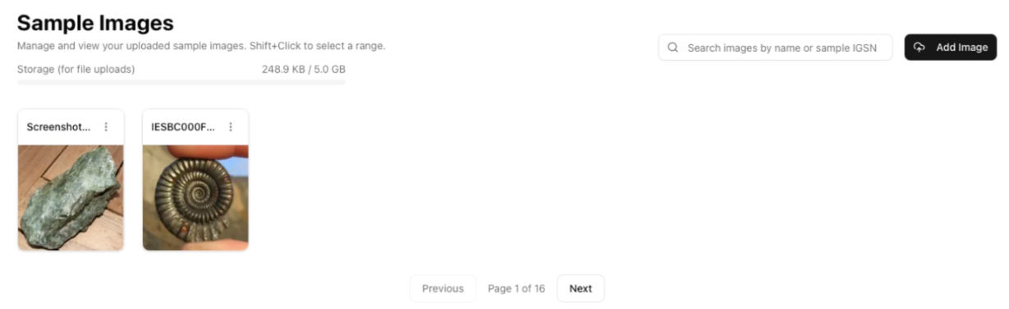
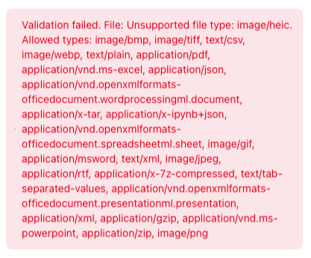
Add Images
Add Image and upload a file or external link
2
1
Add up to 5GB of images under Sample Images
3
Review your image upload.
Images that are too large or do not follow our file formats will not be uploaded and an error message will show.

Slide 3
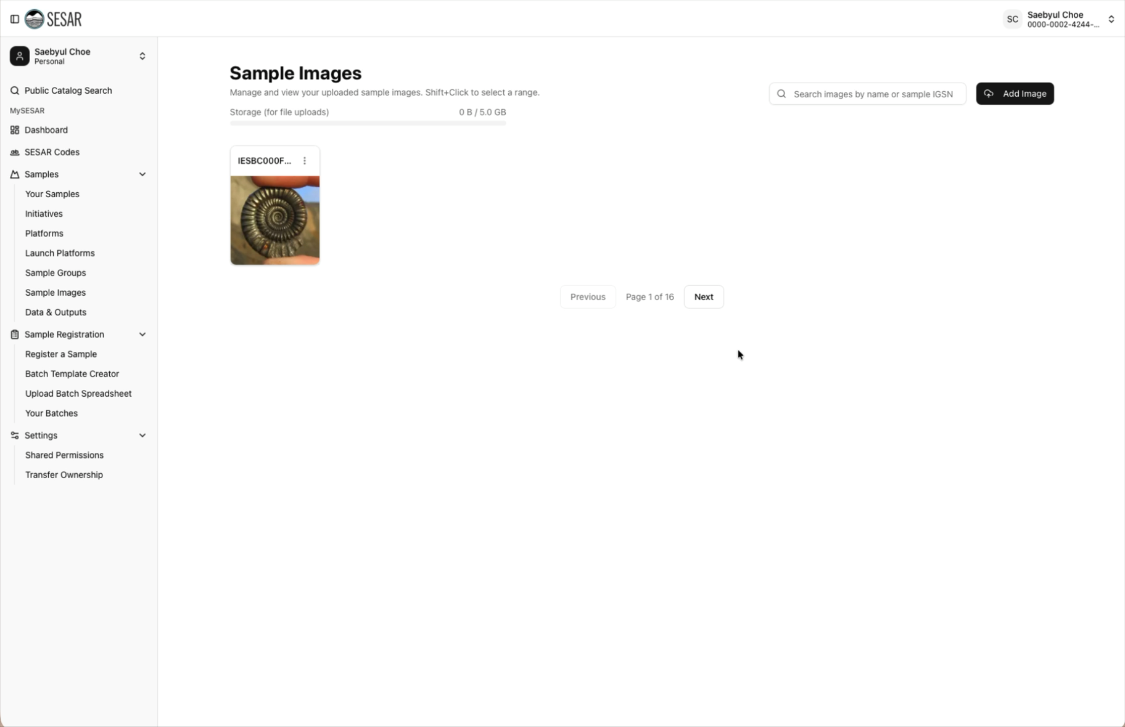
VIDEO Tutorial

Slide 4
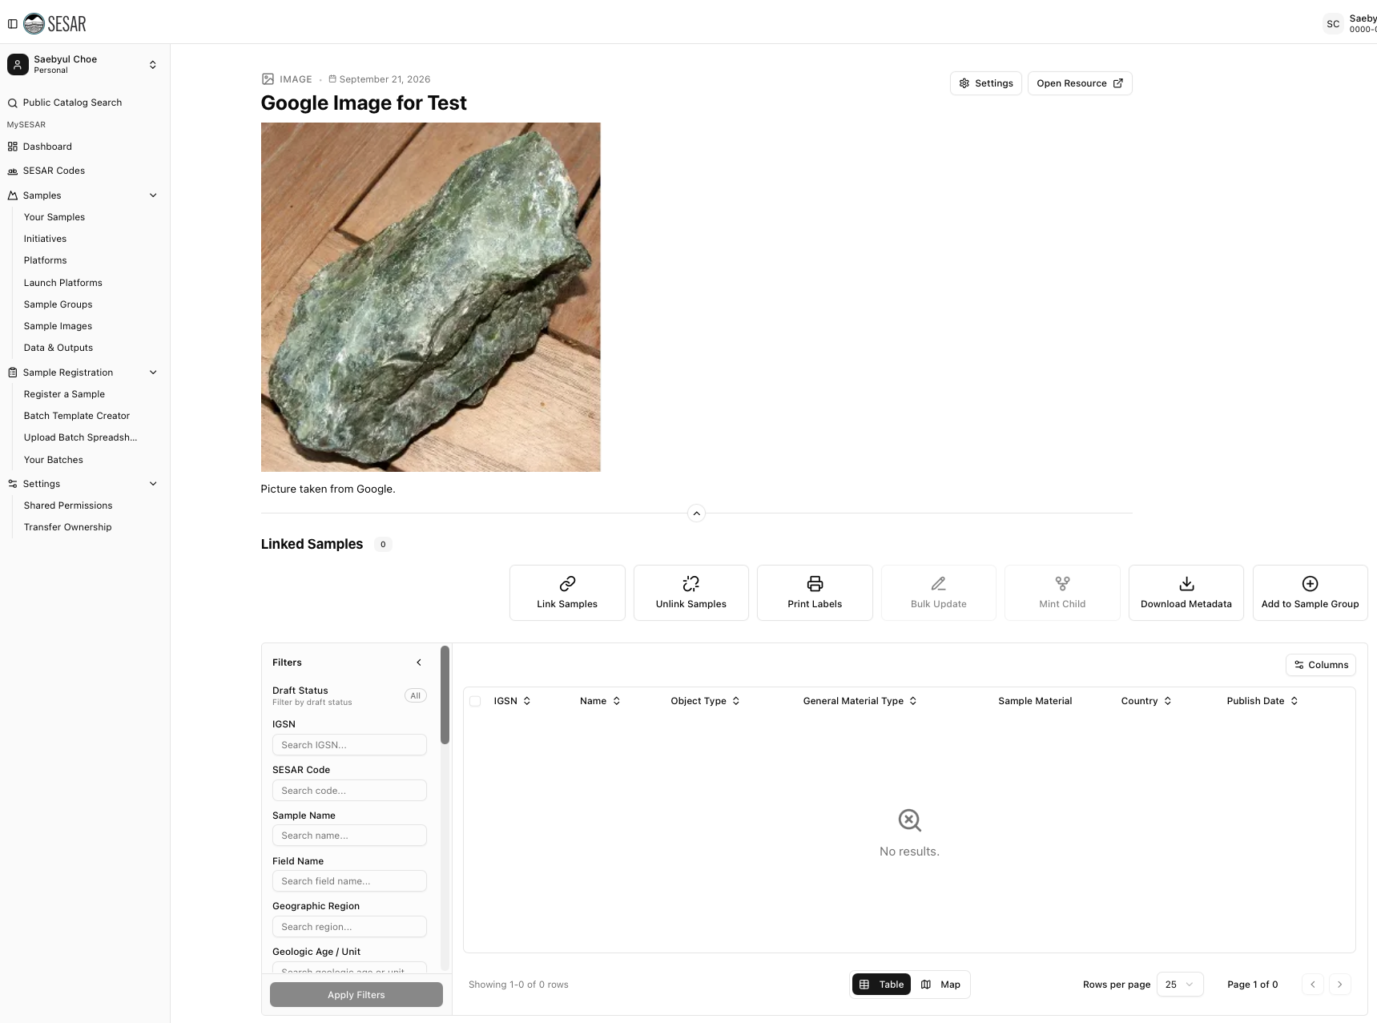
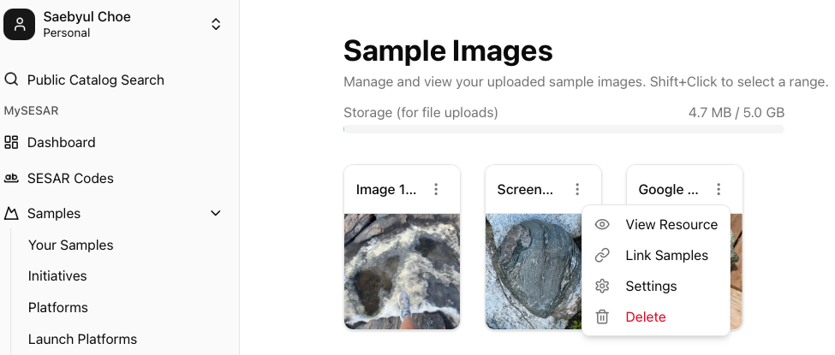
Edit Image
All samples linked to the image will be displayed.
Quick access to Link Samples, Unlink Samples, Print Labels, Mint Child, and other functions are also available for samples associated with an image.
Edit your image by accessing the image page by View Resource.

Slide 5
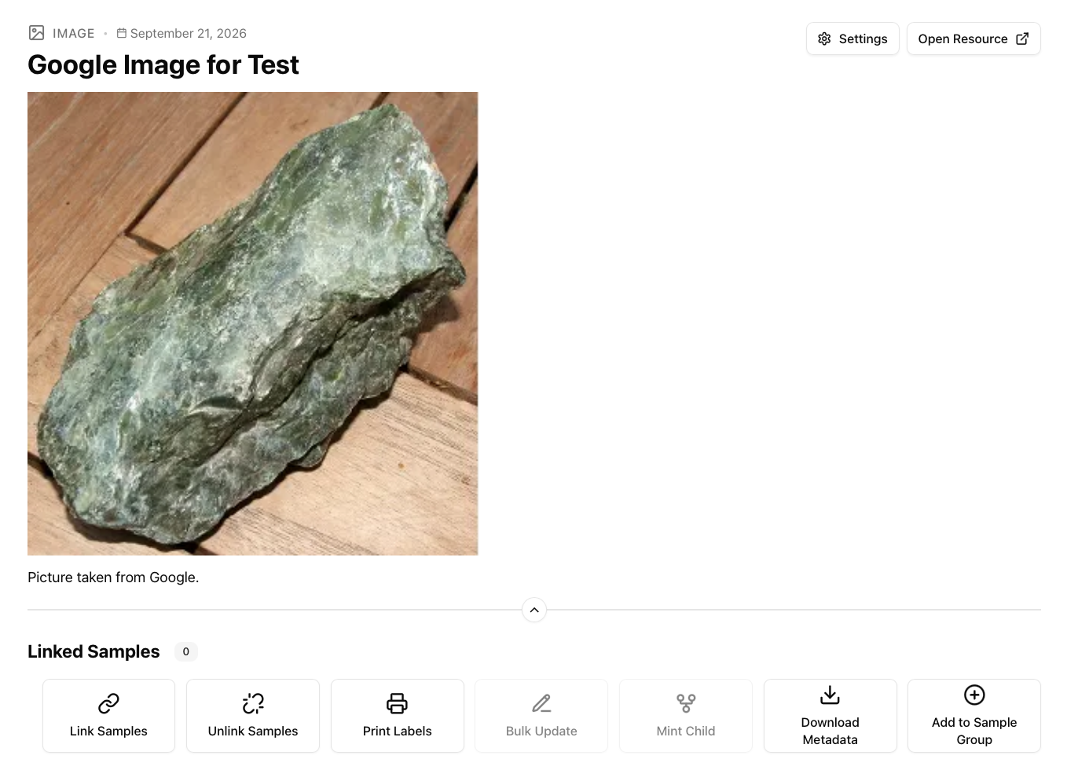
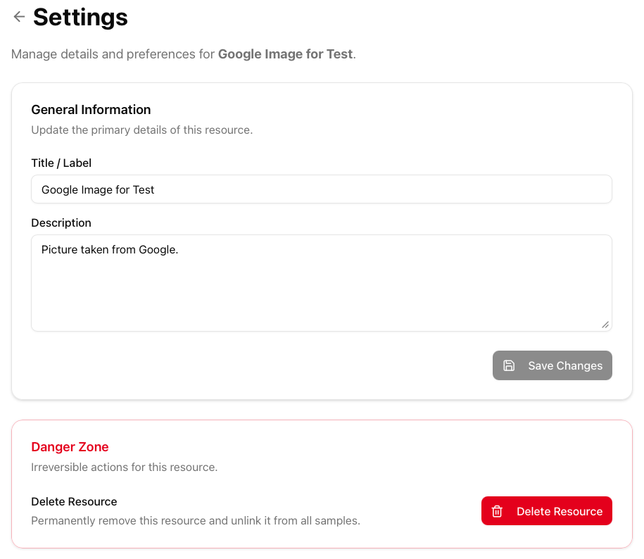
Edit Image
Edit image metadata such as the Title/Label and Description under Settings.
If you want to remove your image, Delete Resource. This will remove the image from your files as well as removing it from any associated samples.

Slide 6
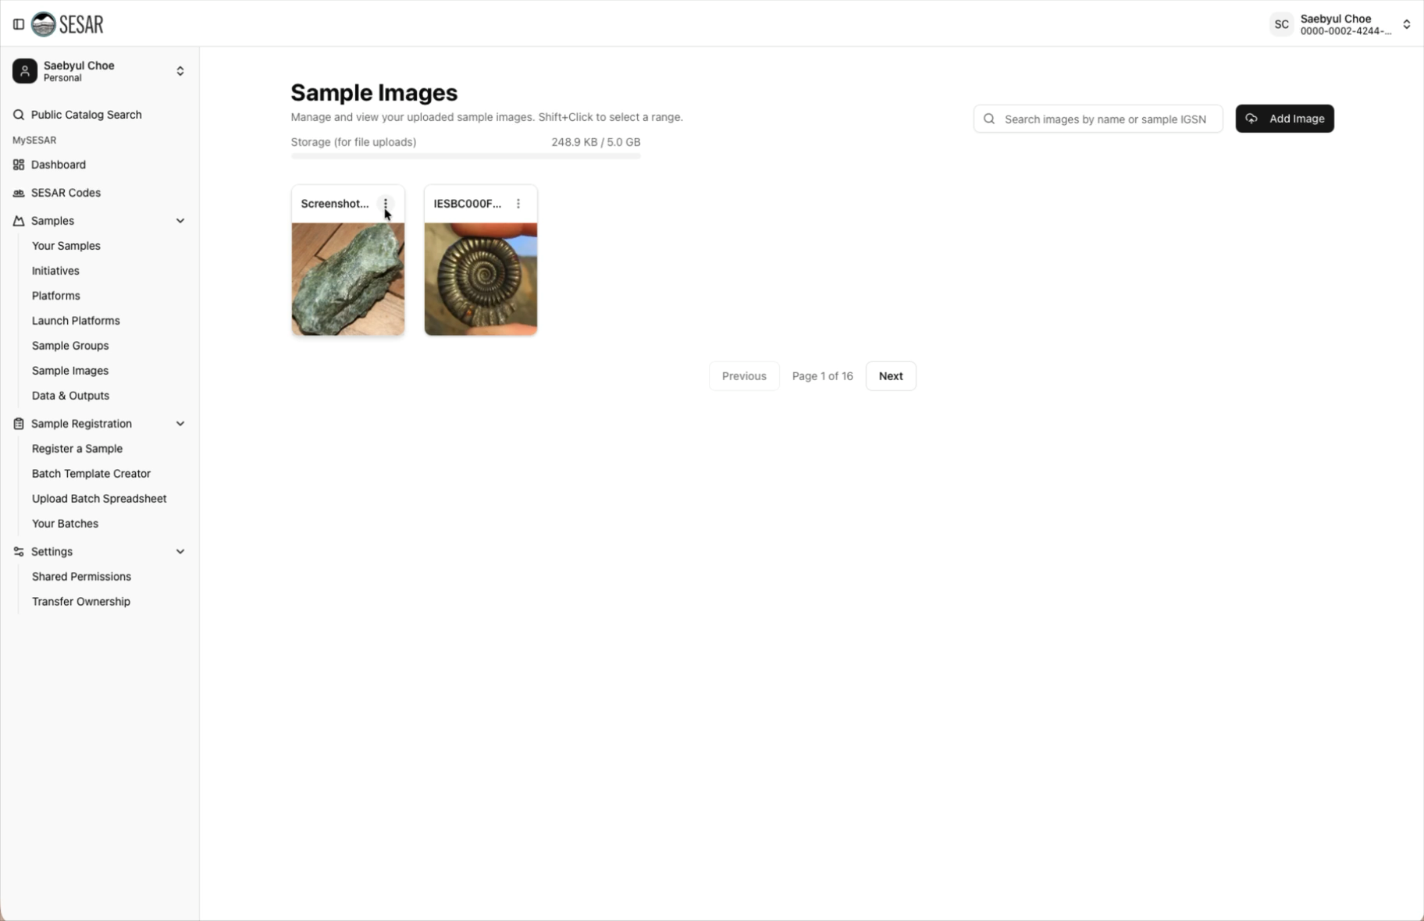
VIDEO Tutorial

Slide 7
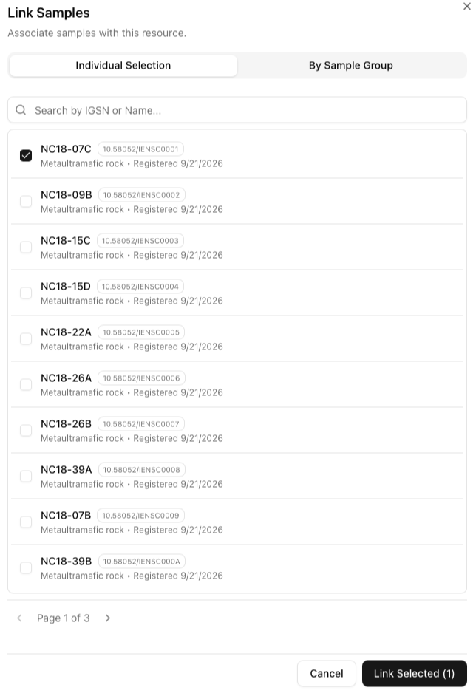
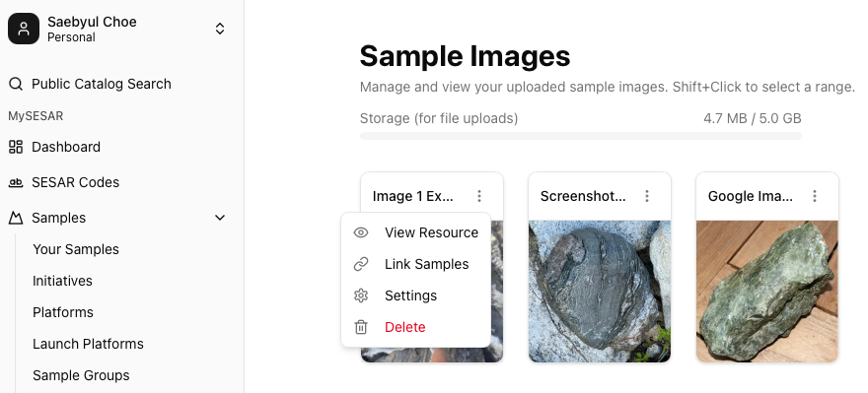
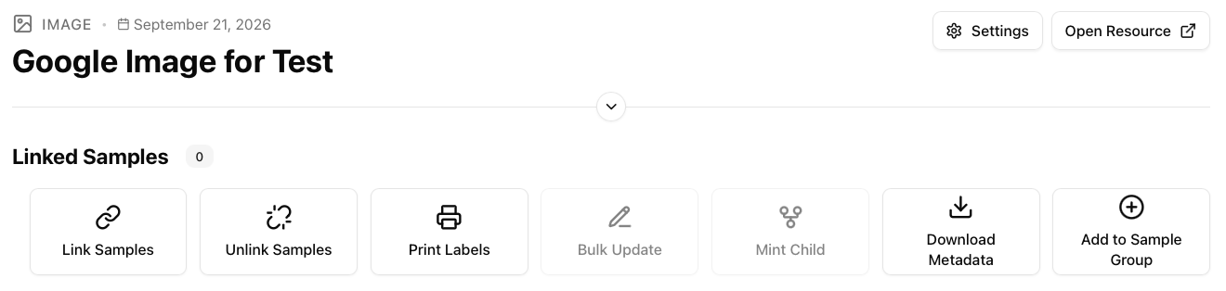
Link Images To Samples
Link images using the three dots and clicking Link Samples.
2
1
Link Samples to images under the image resource under View Resource.
1
3
Select the samples you want to link.
Click Link Selected (X).

Slide 8
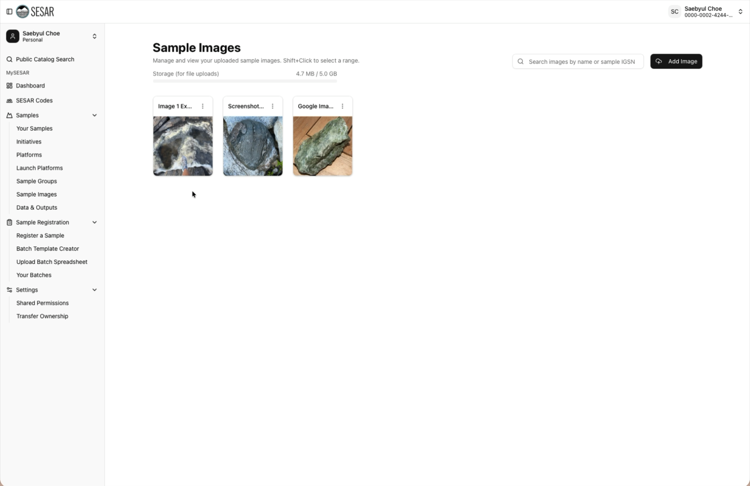
VIDEO Tutorial

Slide 9
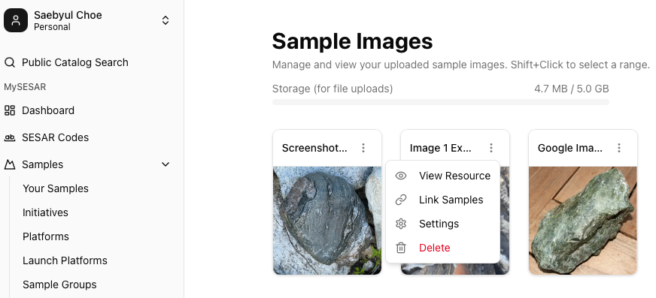
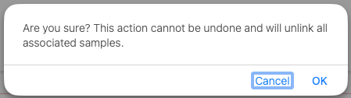
Delete Images
Remove images using the three dots and clicking Delete. You can also delete an image in the image Settings.
All linked samples will be removed with Delete.

Slide 10
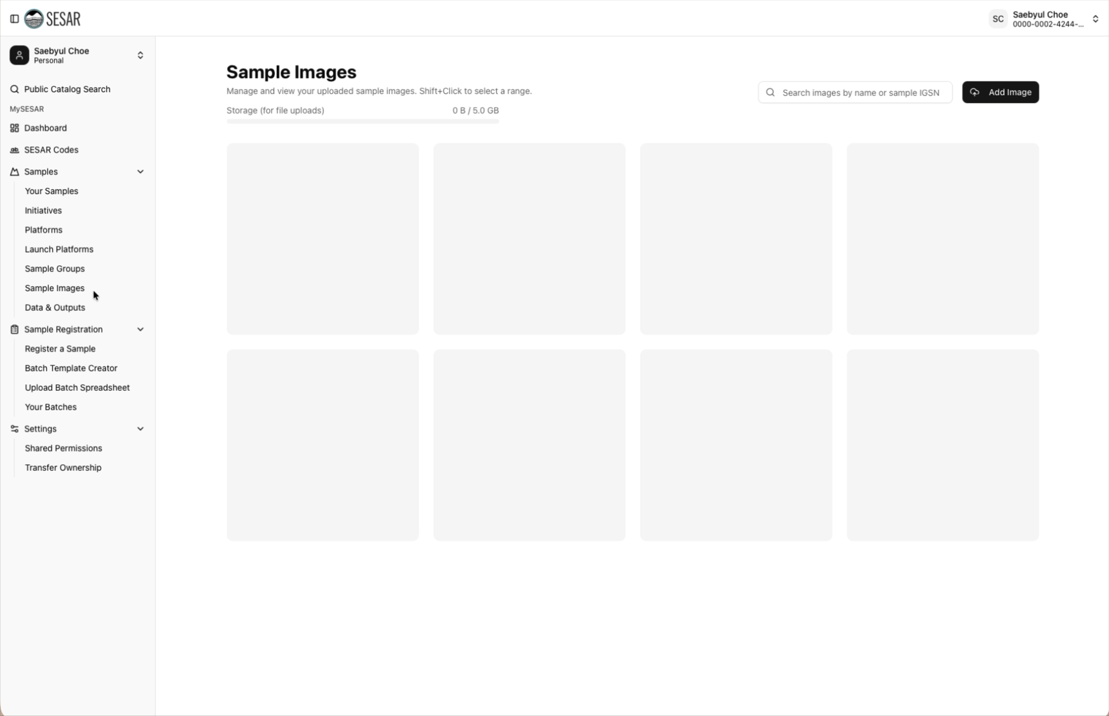
VIDEO Tutorial

